Slide 1
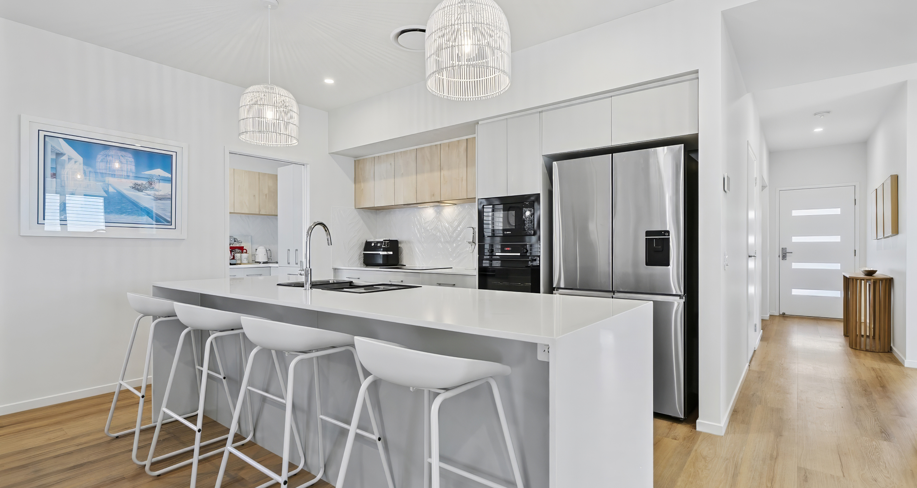
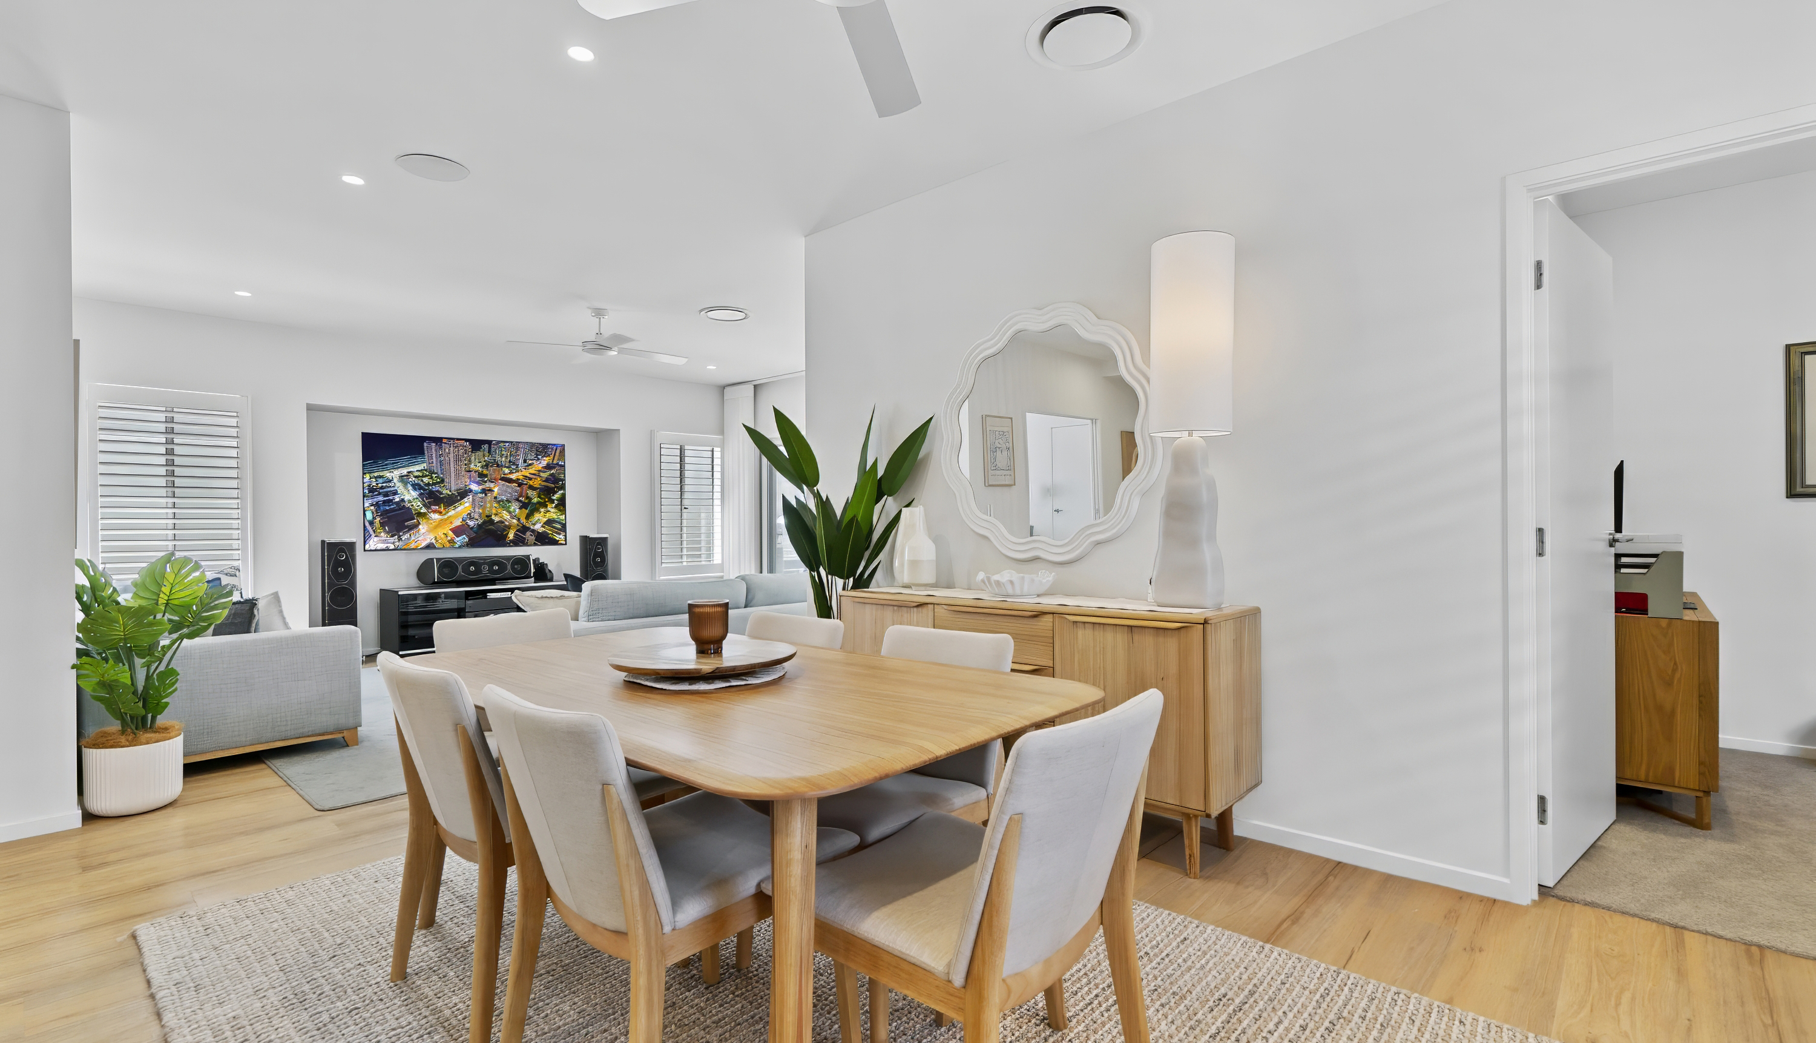




Site 282 B by Halcyon
Site 282/2 Retreat Drive Buderim QLD 4556
3
2
2
1
  Established Sequioa
Welcome to The Sequoia on Site 282, a 300m2 new home site situated in the Waterfall Release at B by Halcyon, just a short stroll to tranquil lakes leading to 5-star facilities. This home is only 12 months old and has been designed with our Luxury Specification package, letting you enjoy the high level of quality. Sit back on the North facing Patio and enjoy barbecuing on the custom-built BBQ deck.
Entertaining friends and family is just so easy in the open plan living area with defined dining and sitting zones, all presided over by high ceilings. Pull back the glass sliders to access your private alfresco living space – or withdraw to the multi-purpose room for an afternoon of sport or Netflix.
Plate up your specialties with style in the sleek centrepiece kitchen, complete with a generous island bench and a dreamy butler’s pantry lined with cupboards, benches and sink with room for all your modern kitchen appliances. Live your best life @ B!
B by Halcyon at Buderim has recently been crowned the ‘Best Senior Living’ in the country, so why wouldn’t you want to call this home? B by Halcyon is not only the best of the best, but there is also simply no better place to B!

Slide 2

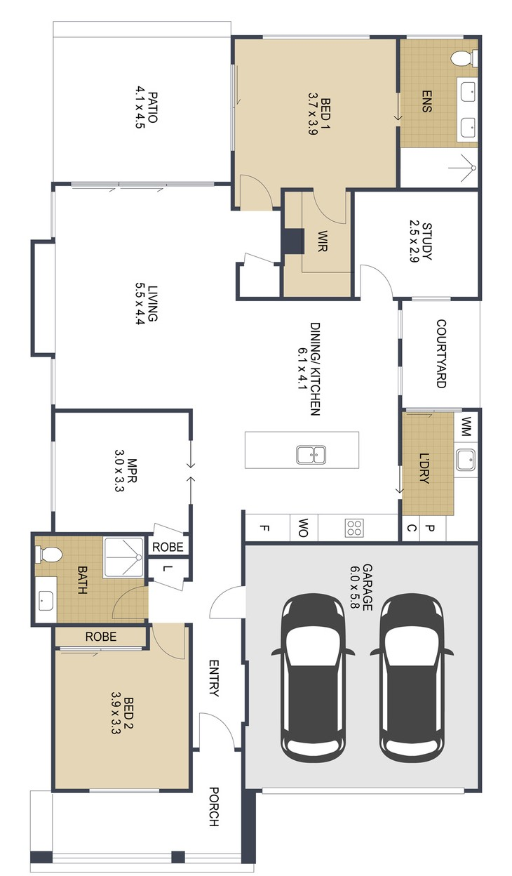
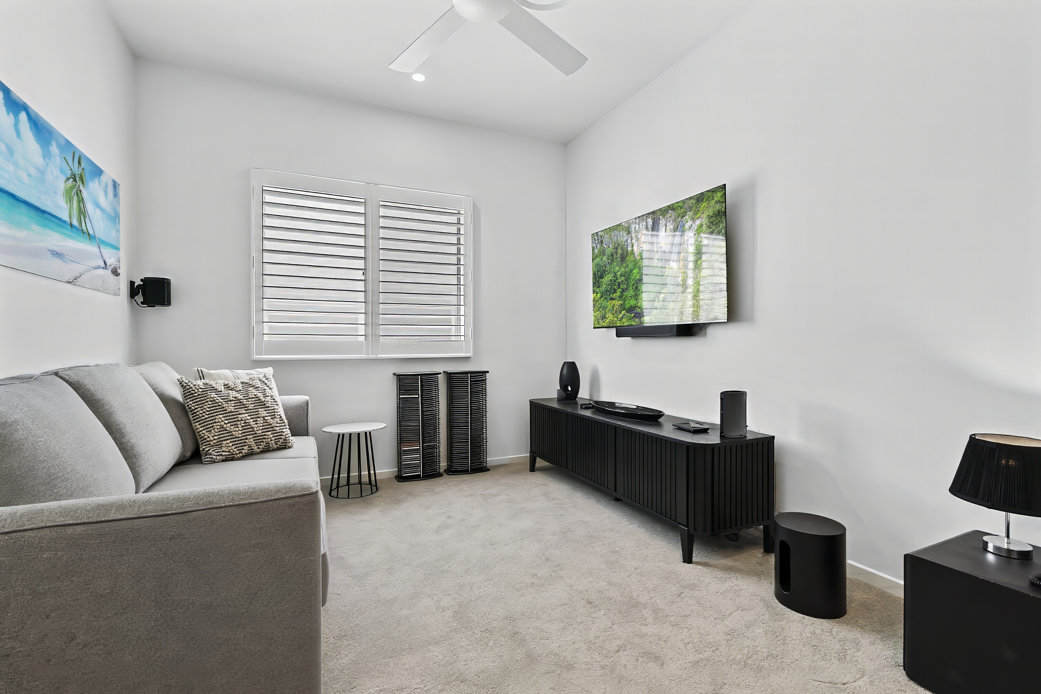
282/ 2 Retreat Drive, Buderim QLD 4556
    $1,170,000
    Inspection by appointment
  Features of the home:
• 2 Beds + Media + Office
• Combined Butler's Pantry & Laundry
• Ducted air conditioning
• 5.4kw solar
• 2700 ceiling height
• Flyscreens to windows & doors
• Plantation shutters to windows & Veri
Shades to sliding doors
• Custom built BBQ deck
• Motorized Patio blinds
Rebecca Husbands
0472 543 892
Rebecca.Husbands@stockland.com.au
Price correct as at 13 March 2025. Subject to change. Subject to availability. Furniture not included.
Floorplans and elevations are for illustrative purposes only. Whilst all care has been taken in the preparation of the particulars contained herein, no warranty can be given and interested parties must therefore rely on their own enquiries. Correct as at 13 Mar 2025.

